Slide 1
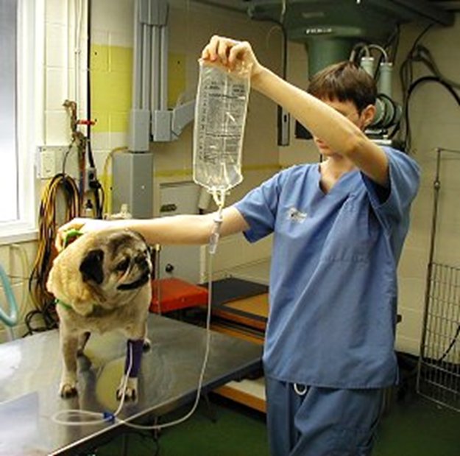
Diagnosing Dehydration
Assist Prof. Luay A. Naeem

Slide 2
Diagnosing Dehydration
Physical exam
Weight loss
PCV (HCT)
  INCREASED
Albumin or total protein
  INCREASED
Creatinine
  INCREASED =“Prerenal azotemia”

Slide 3
Skin Tint
Elasticity of the skin will vary depending on the amount of fat in the subcutaneous tissues
Old animals or thin animals may have reduced skin elasticity
Fat animals may have a normal skin tint even when dehydrated

Slide 4
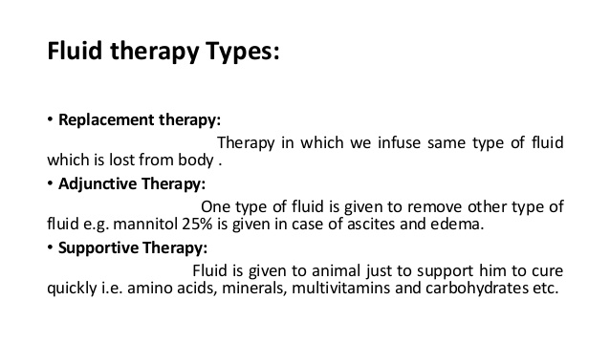

Slide 5
What are the principles and protocols for fluid management?
Prescribing IV fluids: Remember 5 Rs
Routine maintenance.
Resuscitation.
Replacement.
Redistribution.
Reassessment.

Slide 6
Fluids: How Much to Give?
Correct dehydration
Weight in kg times percent dehydration equals the amount in liters that the animal is dehydrated
Example: 10 kg animal who is 8% dehydrated
10kg X 0.08 = 0.8 liters
Patient is lacking 0.8 liters, or 800 ml fluids

Slide 7
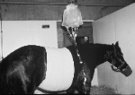
How Much to Give?
  Correct dehydration
Maintenance fluids
Anyone remember daily maintinance fluid rate?

Slide 8
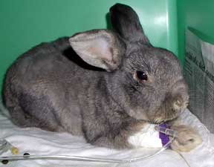
Maintenance Fluids
30 ml/pound/day
10 pound animal needs:
10 X 30ml/lb =300 ml/day

Slide 9
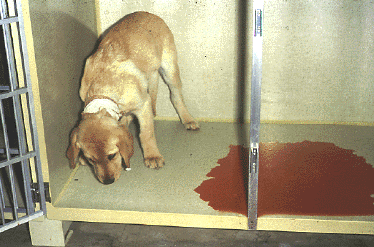
How Much to Give?
  Correct dehydration
  Maintenance fluids
On-going losses

Slide 10
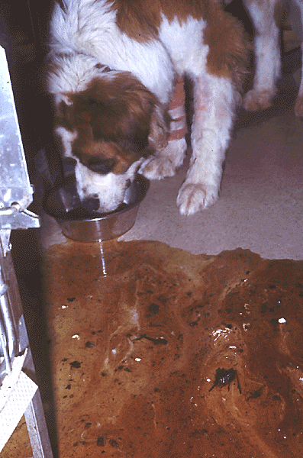
On-going Losses
Sensible losses
  GI disease
    Vomiting/diarrhea
  Renal disease
    Low specific gravity
  Diabetes mellitus
Insensible losses (evaporation/diffusion)
  Weigh to determine

Slide 11
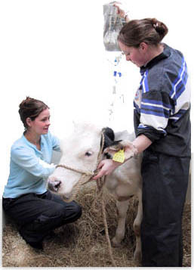
Fluid Needs
Correct dehydration
Maintenance needs
On-going losses

Slide 12
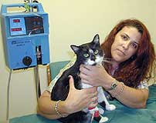
Principles of Rehydration
Correct dehydration, electrolyte, and acid-base abnormalities prior to surgery

Slide 13
Principles of Rehydration
2. Do not attempt to replace chronic fluid losses all at once
  Severe dilution of plasma proteins, blood cells and electrolytes may result
Aim for 80% rehydration within 24 hours
Monitor pulmonary, renal and cardiac function closely

Slide 14
Types of Fluids
Crystalloids
  0.9% NaCl
  Lactated Ringers Solution
  Ringers Solution
  5% Dextrose in water
  Plasmalyte, Normosol, etc

Slide 15
Crystalloid Fluids
Isotonic
  Mimic plasma electrolyte concentrations
Hypertonic
  Follow with isotonic

Slide 16
Lactated Ringer’s Solution
  Contains physiological concentrations of: sodium, chloride, potassium, and calcium
Also contains lactate, which is metabolized by the liver→ alkaline-forming Because small animals that are sick or under anesthesia tend towards acidosis

Slide 17
Ringer’s Solution
Same as LRS except no lactate added
Commonly used in Large animals
Why?
  Large animals who are sick tend towards alkalosis instead of acidosis

Slide 18

Saline
0.9% Sodium chloride = ISOTONIC
Lacking in K+, Ca2+
Used for hyperkalemia, hypercalcemia
Used as a carrier for some drugs
Used if don’t want lactate

Slide 19
Dextrose Solutions
5% dextrose is isotonic
50% dextrose commonly found
Used for hypoglycemia, neonates, hyperkalemia, as part of Total Parenteral Nutrition

Slide 20
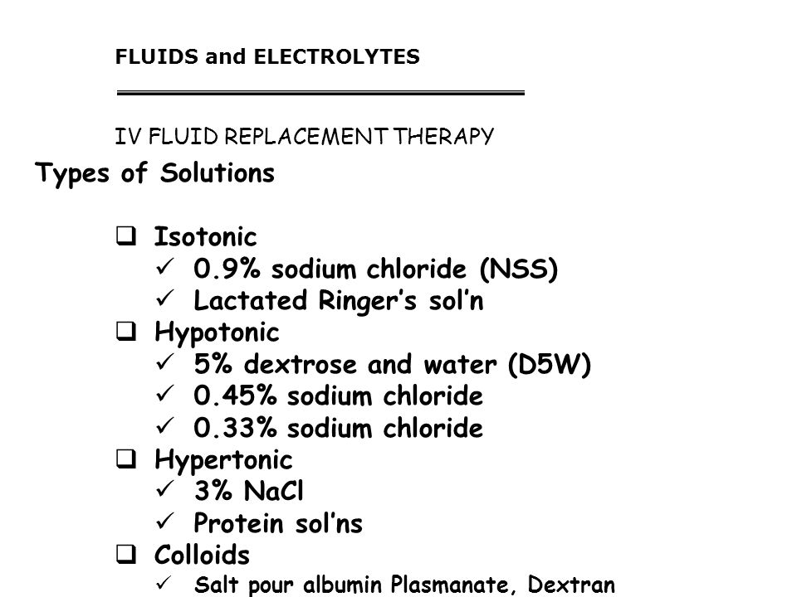

Slide 21
What criteria should be considered before prescribing IV fluid therapy for a post op patient?
Age
Sex
Body weight.
Pre op hydration status of the person.
Associated co morbidities.
Type of surgery.
Duration of surgery.
Blood loss.

Slide 22
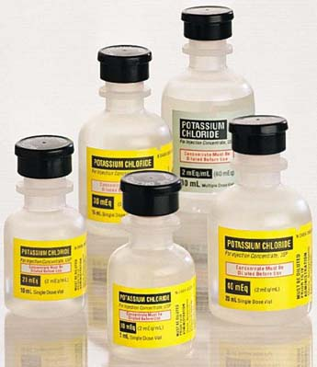
Additives for Crystalloid Solutions
Potassium
  available as potassium chloride (KCl)
  available as potassium phosphate (K3PO4)
Very common additive
  20 meq in 10 ml bottle

Slide 23
Potassium
DANGER: Rates higher than 0.5 meq/kg/hr will stop the heart
Added to fluids at 10-80 meq/L
  Amount depends on how low K is
  Obtain WRITTEN approval from vet
IF ADDING >40meq to L (2 btls)
  DOUBLE CHECK with Veterinarian

Slide 24
Calculating Safe Rates for Infusions Containing KCl
Remember me??
(Weight) (Dosage)
Concentration
Body weight in kg X 0.5 meq/kg/hr = maximum amount of potassium allowable
Figure out the concentration of the fluids being administered in terms of meq/ml
Divide weight times dosage by the concentration of potassium in the fluids
Answer is the fastest allowable rate per hour
  Set rate less than this to be safe

Slide 25
Step 1: Maximum Dose
Body wt in kg X 0.5 meq/kg/hr = maximum amount of potassium allowable
8.8 pound cat ÷ 2.2 = 4 kg
4 kg cat X 0.5 meq/kg/hr = 2 meq per hour allowable

Slide 26
Step 2: Figure Out the Concentration
If fluids contain 60 meq/l then each ml contains 0.06 meq (60 divided by 1000 ml in a liter)
60 meq x 1 liter 60meq 0.06meq
1 liter 1000 ml = 1000ml = ml

Slide 27
Step 3: Divide Dose by Concentration
Divide dose (2 meq/hr) by concentration (0.06 meq/ml)
2meq/hr
0.06 meq/ml = 33 ml/hr
Maximum safe rate would be 33 ml/hr

Slide 28
Weight X Dosage
Concentration

Slide 29
Sodium Bicarbonate
Alkalinizing
Used for severe acidosis
  Antifreeze toxicity
  Ketoacidosis associated with diabetes mellitus
Do not add to calcium-containing fluids or calcium precipitates will occur

Slide 30
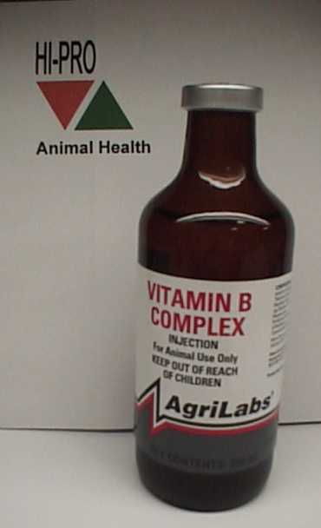
B Vitamins
B Complex
Frequent additive; water-soluble effects
Turns bag yellow
Protect from light
1-2 ml/liter
Appetite Stimulant,
Replaces lost B vitamin

Slide 31
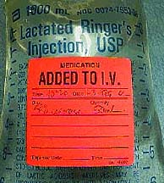
Additives
Always label the fluid bag with the amount and concentration of all additives immediately!
Date fluids

Slide 32
Daily Monitoring While on Fluids:
Weigh patient daily

Slide 33
Daily Monitoring
Auscult the lungs
  Crackles
  Wheezes
  Nasal discharge
    Serous

Slide 34
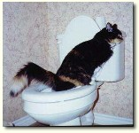
Daily Monitoring
Urine production

Slide 35
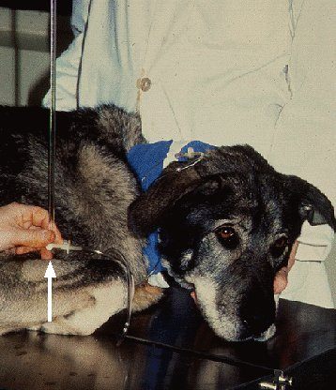
Daily Monitoring
Central venous pressure

Slide 36
Daily Fluid Monitoring
Overdose:
  Serous nasal discharge
  Dyspnea, crackles
  Restlessness
  Decreased PCV, TP
  Increased BP

Slide 37
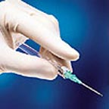
IV Catheters
Size: In GAUGES like needles
  Smaller = BIGGER
Types:
  Cephalic
    How long in?
  Jugular
    How long in?
    Other Advantages?

Slide 38
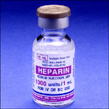
Flushing
Flush w/ Heparinized Saline
  1cc (1,000/mL) into 1000mL
Flush after first piece of tape
  Make sure it’s in
Flush before each injection
Flush after each injection
Flush every 4-6 hours if not used

Slide 39
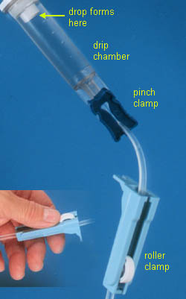
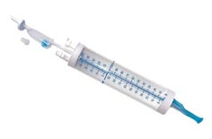
So How Is It Delivered?
Infusion pump (easy)
IV drip set: drops per ml written on package
Regular Drip sets have 10, 15, or 20 drops per ml
  Med – large dogs
Micro drip sets have 60 drops per ml
  Small dogs - cats

Slide 40
Intra-operative Fluids:
10 ml/kg/hr first hour, then reduce to 5ml/kg/hr
Example: 10 kg dog would get:
  (10 ml/kg) (10 kg) = 100 ml in the first hour
  50 ml in the second hour

Slide 41
Calculate Drops Per Hour
1. Calculate ml/hr (as far as you go for PRI)
2. Calculate drops/hr by:
  ml/hr X drops/ml (from the package)
  Gives you drops needed in an hour
Example: 100 ml X 10 gtt per ml = 1000 drops in the first hour

Slide 42
Calculate Drops Per Minute
3. Divide drops per hour by 60 min/hr to get drops per minute
Ex: 1000 gtt/ hr divided by 60 minutes per hour = 16.7 gtt per minute
16.7 gtt/min divided by 60 sec per min = 0.28 gtt/sec

Slide 43
So What?
What if you don’t want to count drops over a whole minute?
If you want to count over a 30 second period of time, then divide by two
If you want to count over a 15-second period of time, divide by four

Slide 44
Ex: 16.7/min divided by 2 = about 8 drops over 30 seconds
16.7/min divided by 4 equals about 4 drops over 15 seconds

Slide 45
All together…
x kg x 10mL x 1 hr x 1 min x x gtt
1 kg/hr 60min 60 sec mL
= wt x 10 x gtt Gives you gtt/sec
  3600 sec
  Then make it into a usable # of gtt / so many sec

Slide 46
Calculating Fluid Requirements in Hospitalized Animals
Maintenance fluids
plus
Replacement fluids (80% of deficit) plus
On-going losses
equals
Total Fluid needs over 1st 24 HRS

